Slide 1
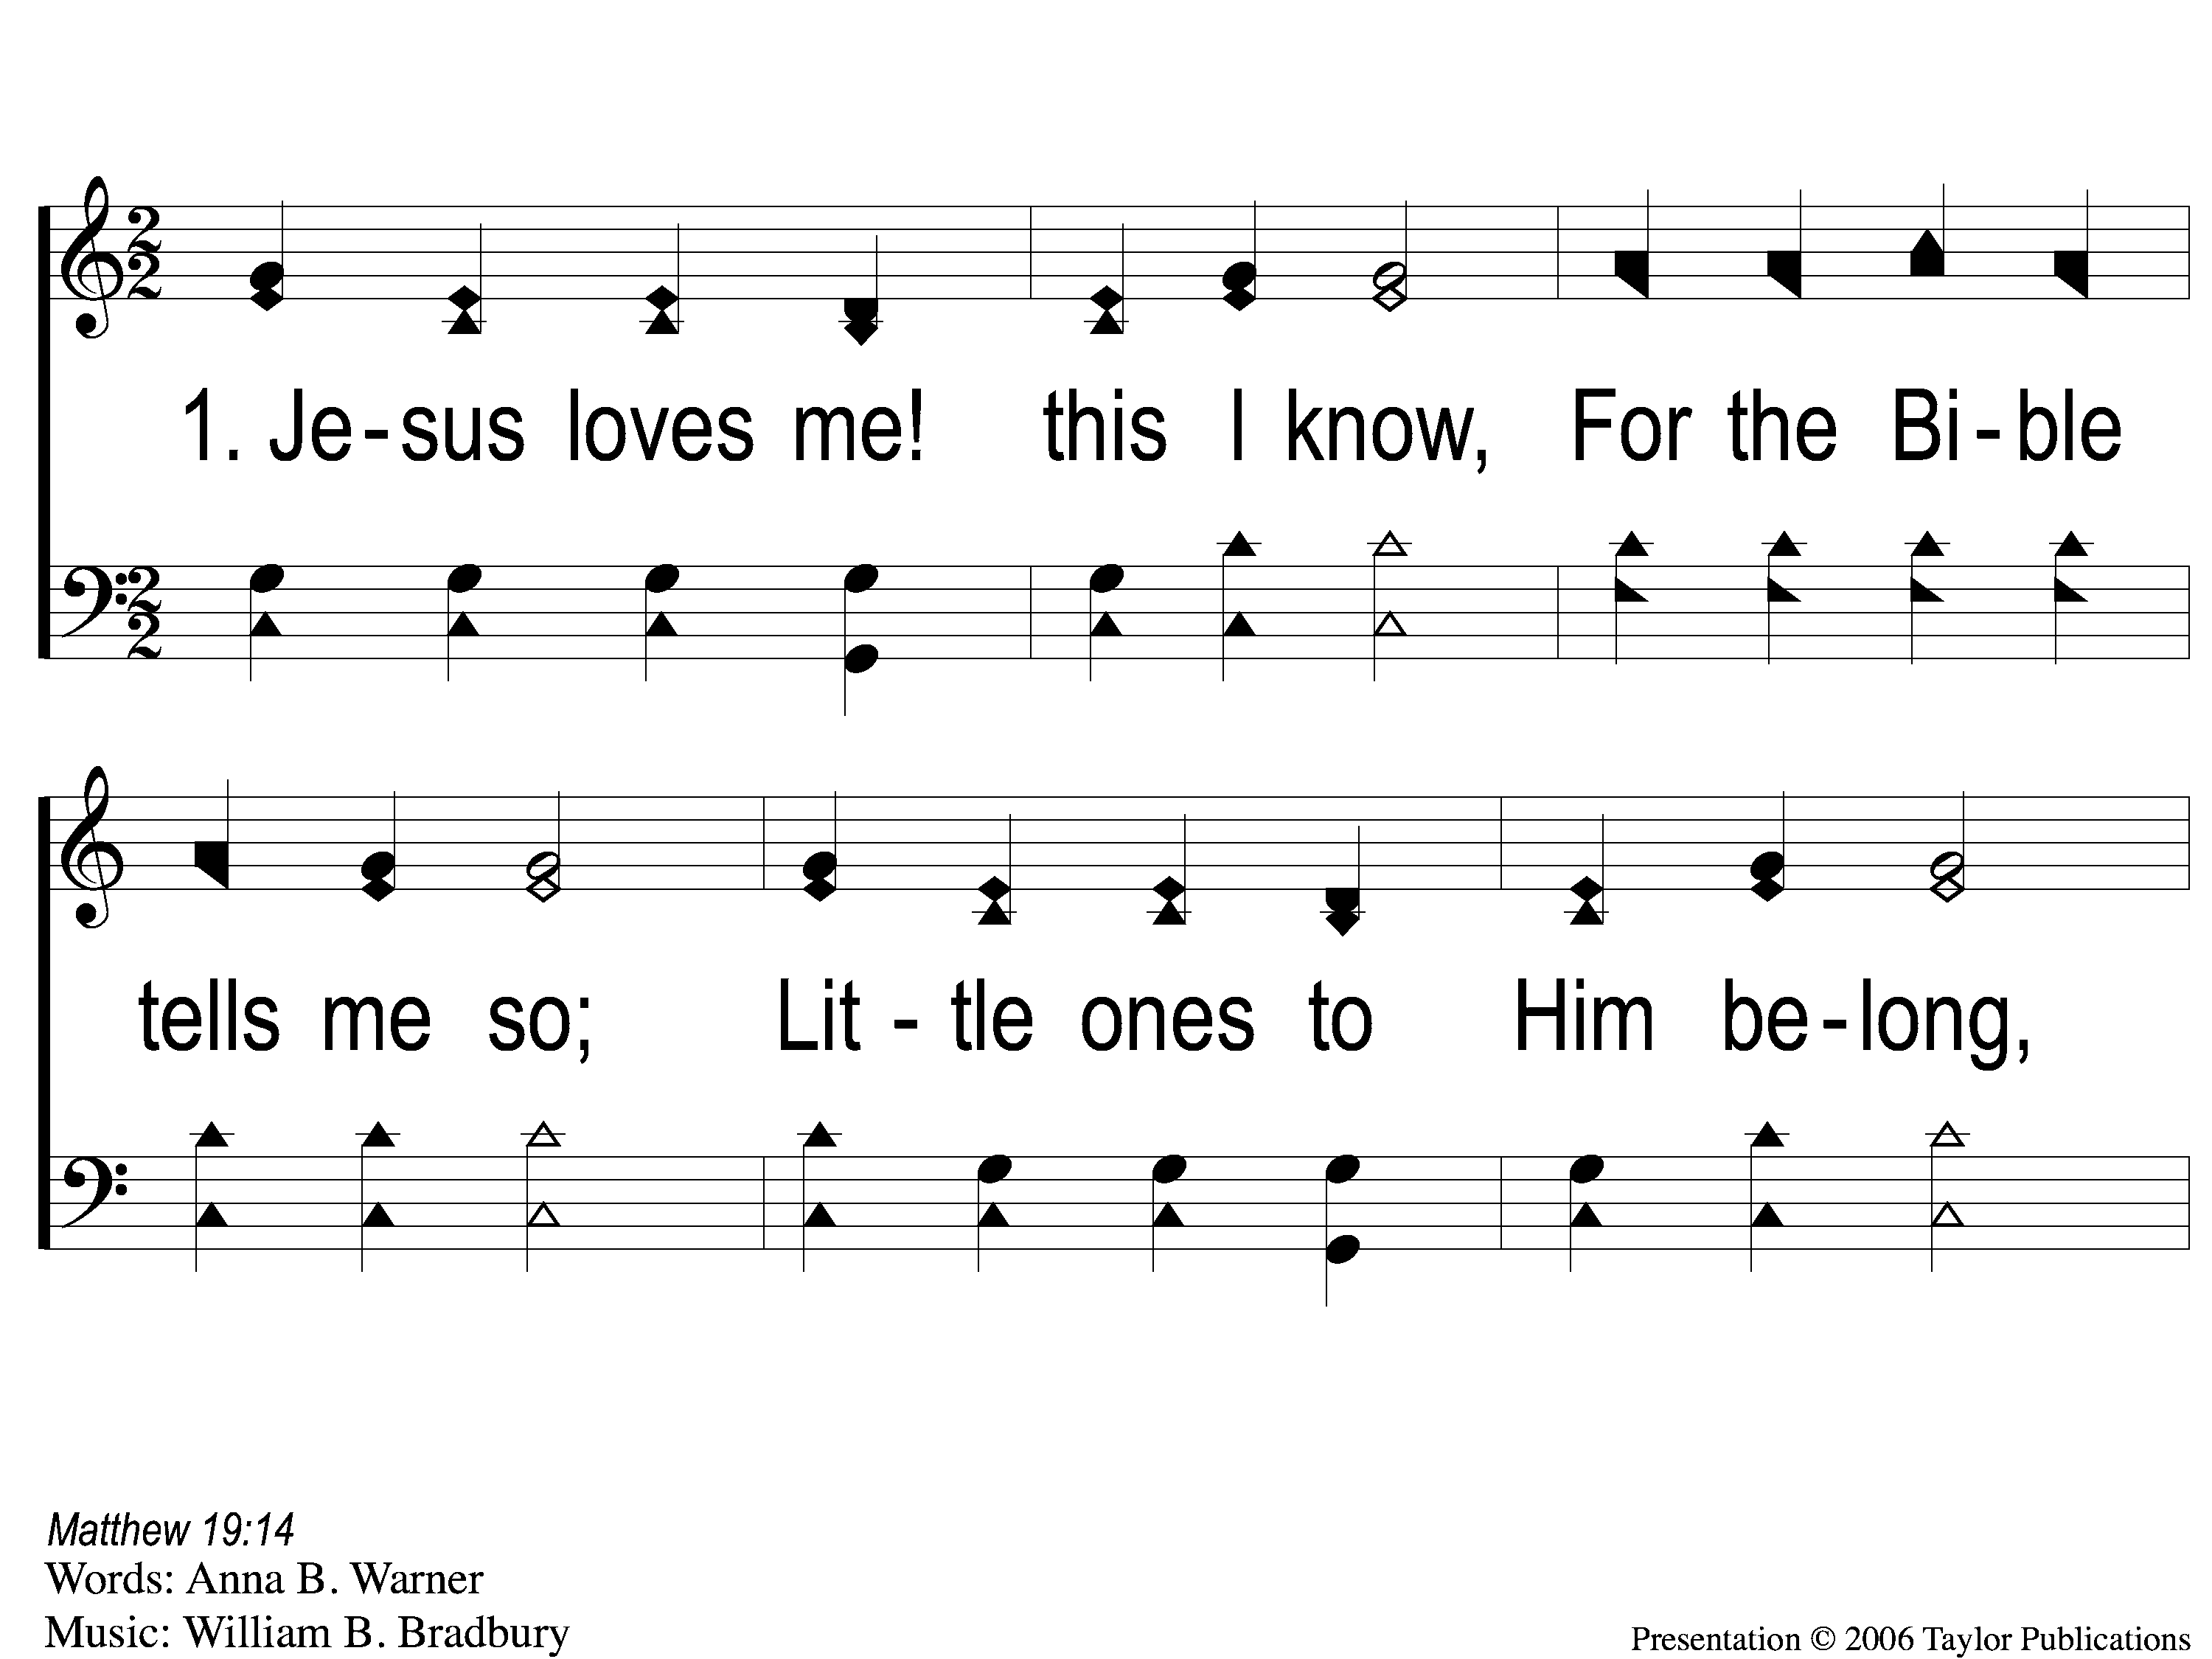
1-1 Jesus Loves Me This I Know
Jesus Loves Me
108

Slide 2
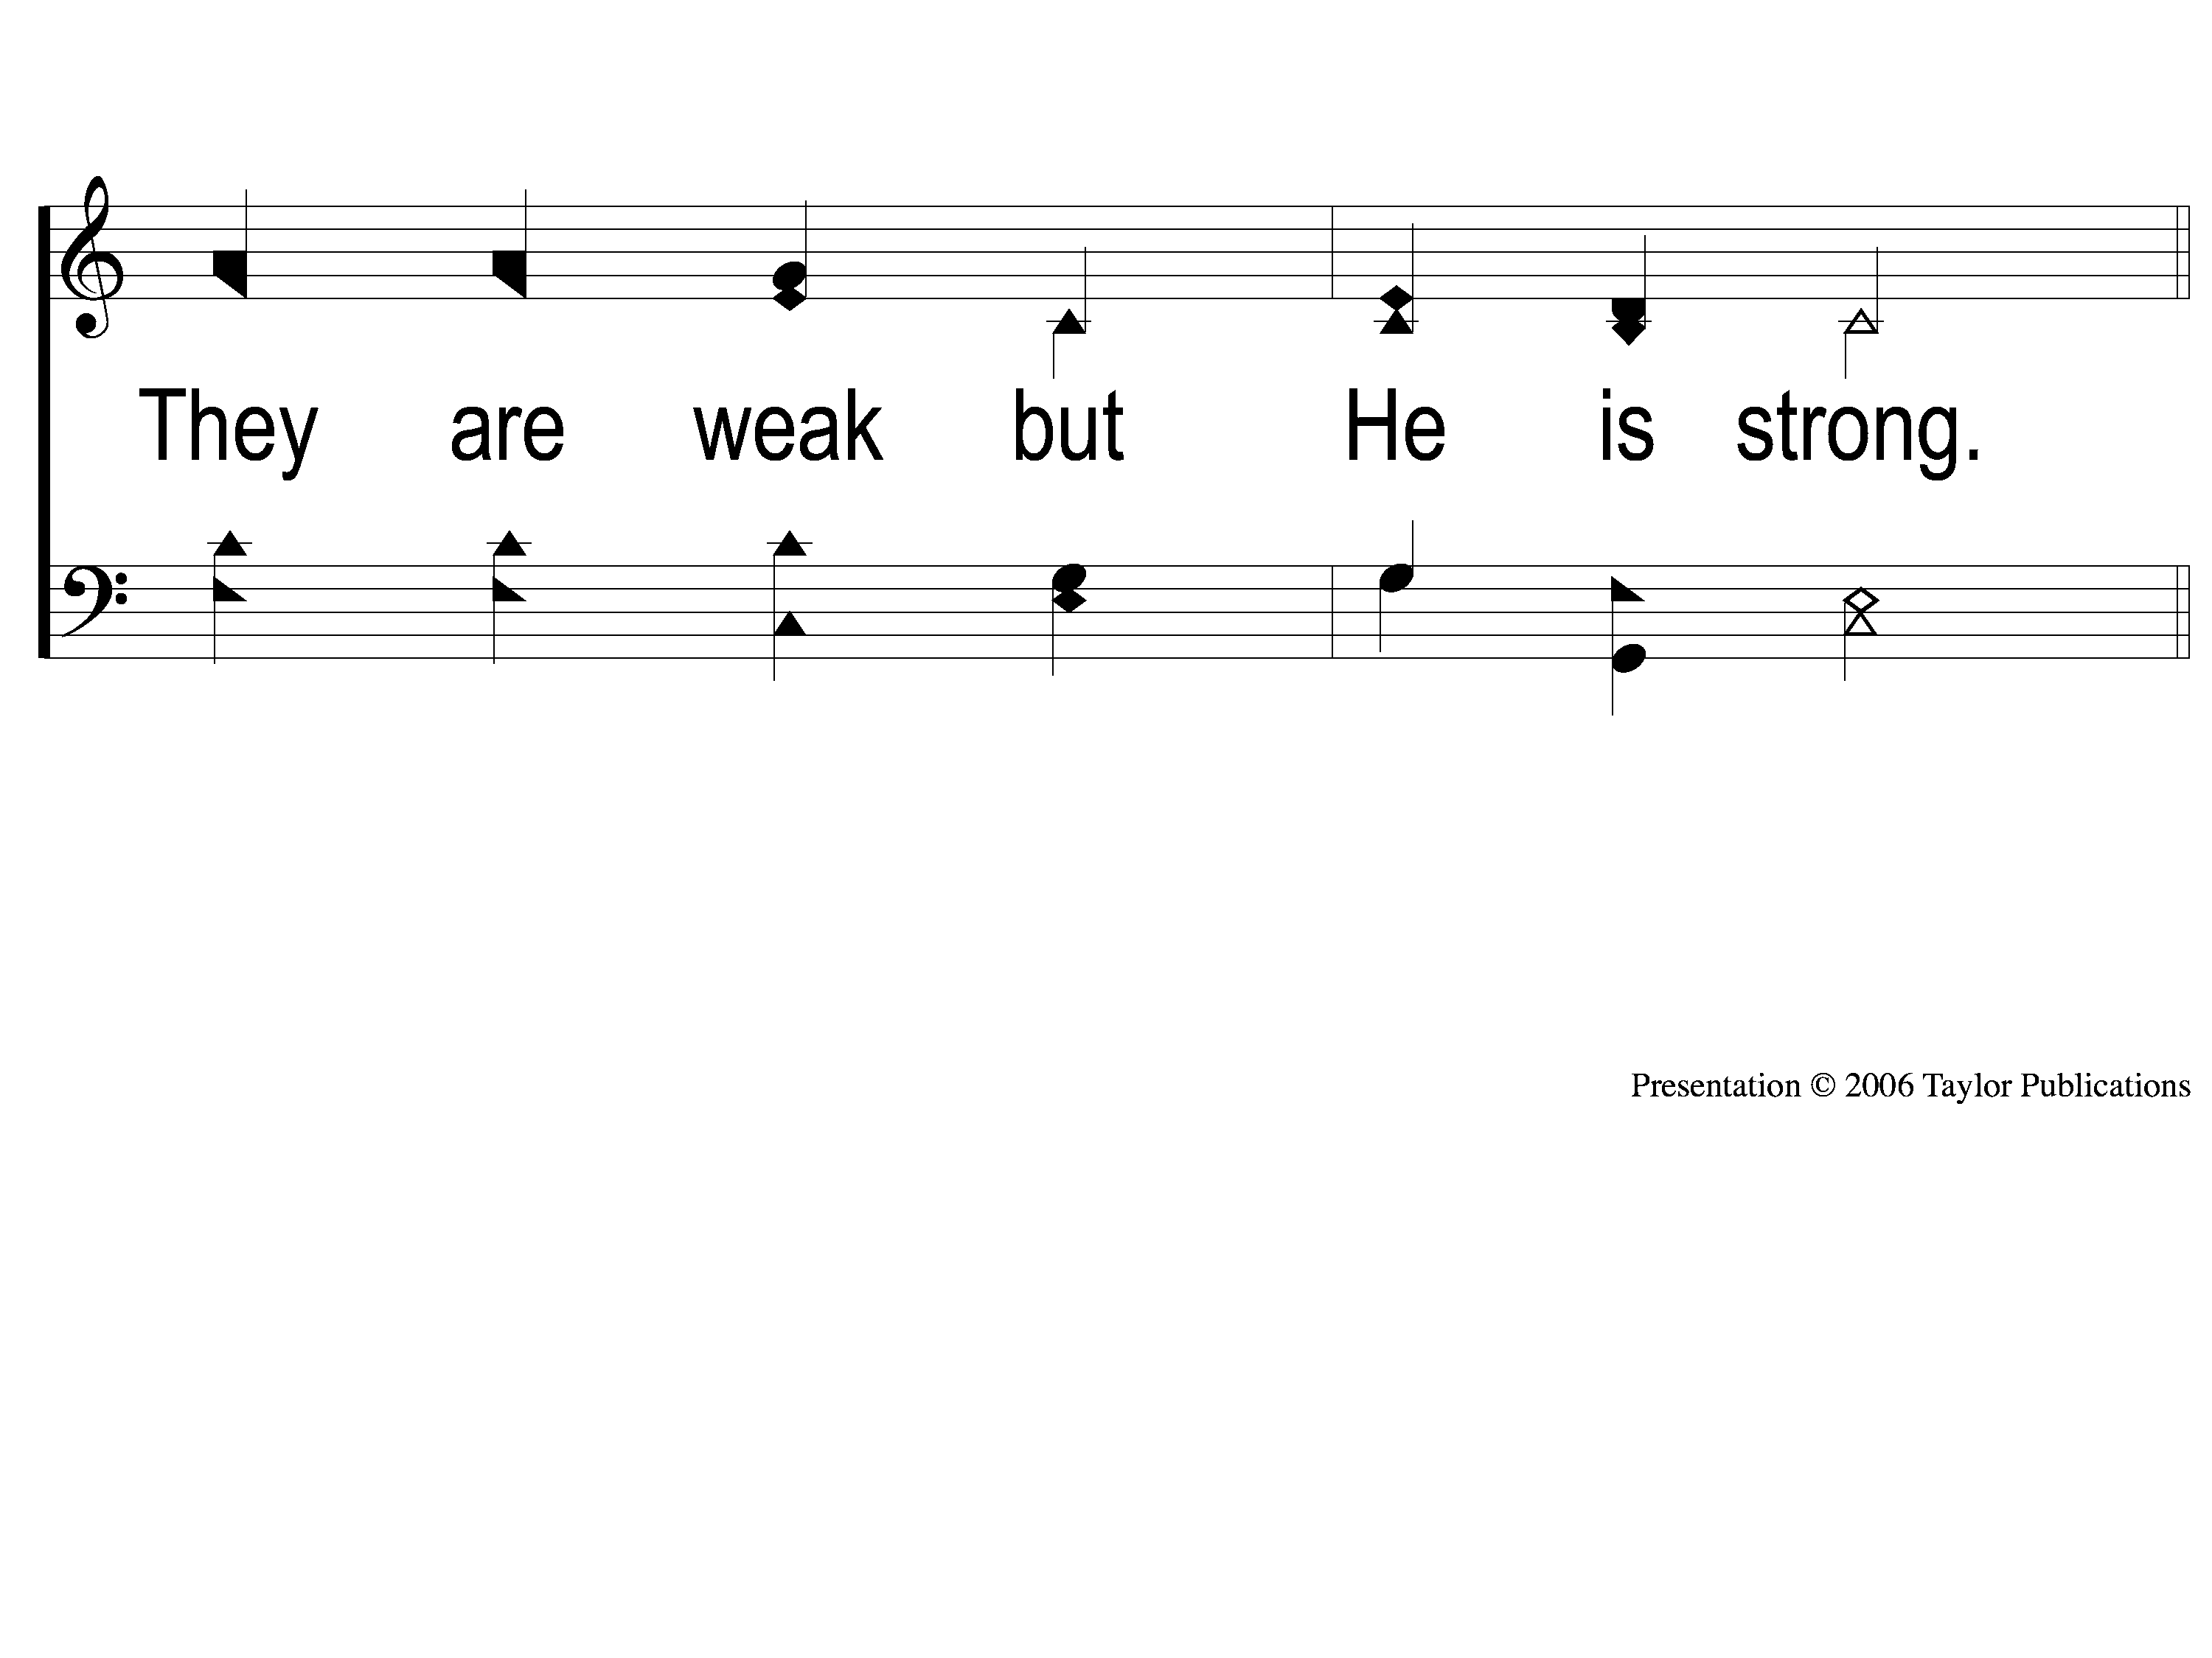
1-2 Jesus Loves Me This I Know
Jesus Loves Me
108

Slide 3
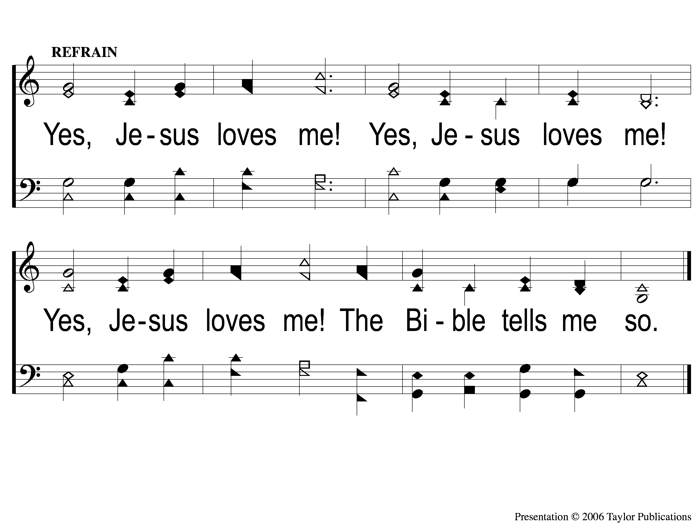
C Jesus Loves Me This I Know
Jesus Loves Me
108

Slide 4
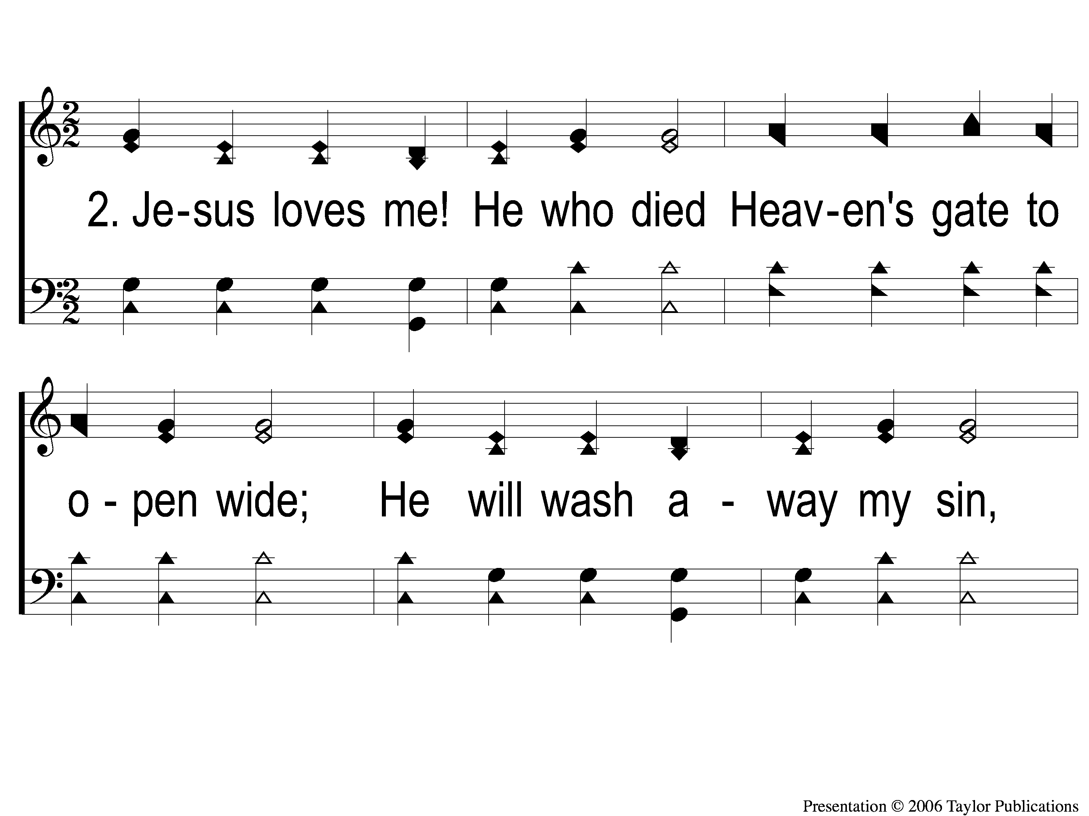
2-1 Jesus Loves Me This I Know
Jesus Loves Me
108

Slide 5
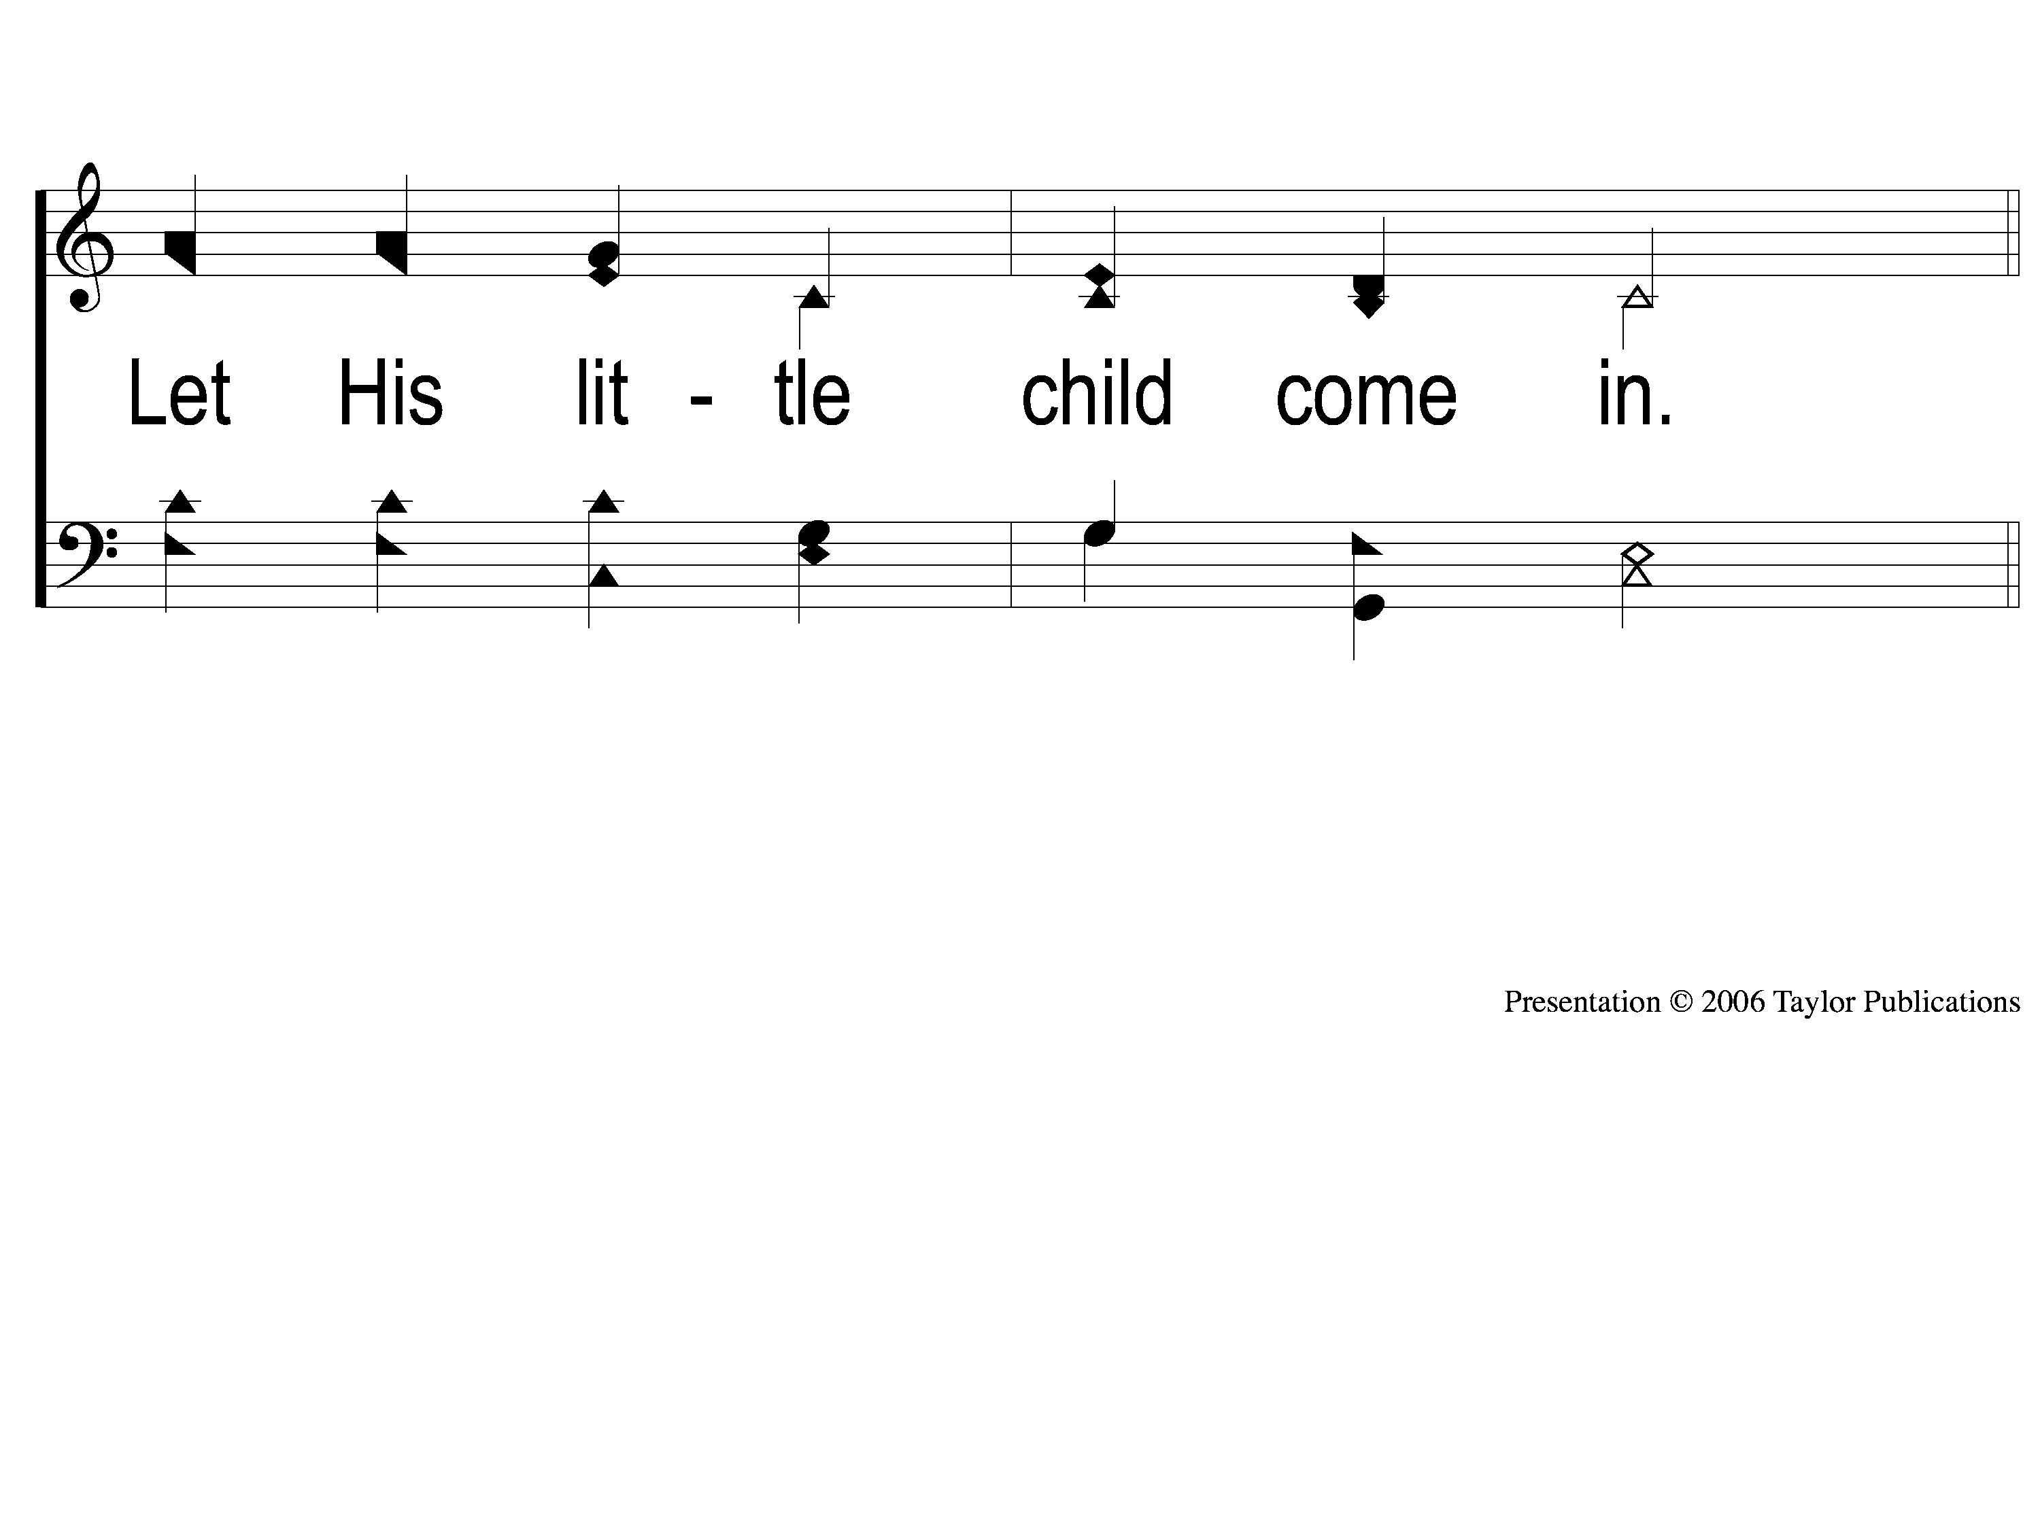
2-2 Jesus Loves Me This I Know
Jesus Loves Me
108

Slide 6
C Jesus Loves Me This I Know
Jesus Loves Me
108

Slide 7
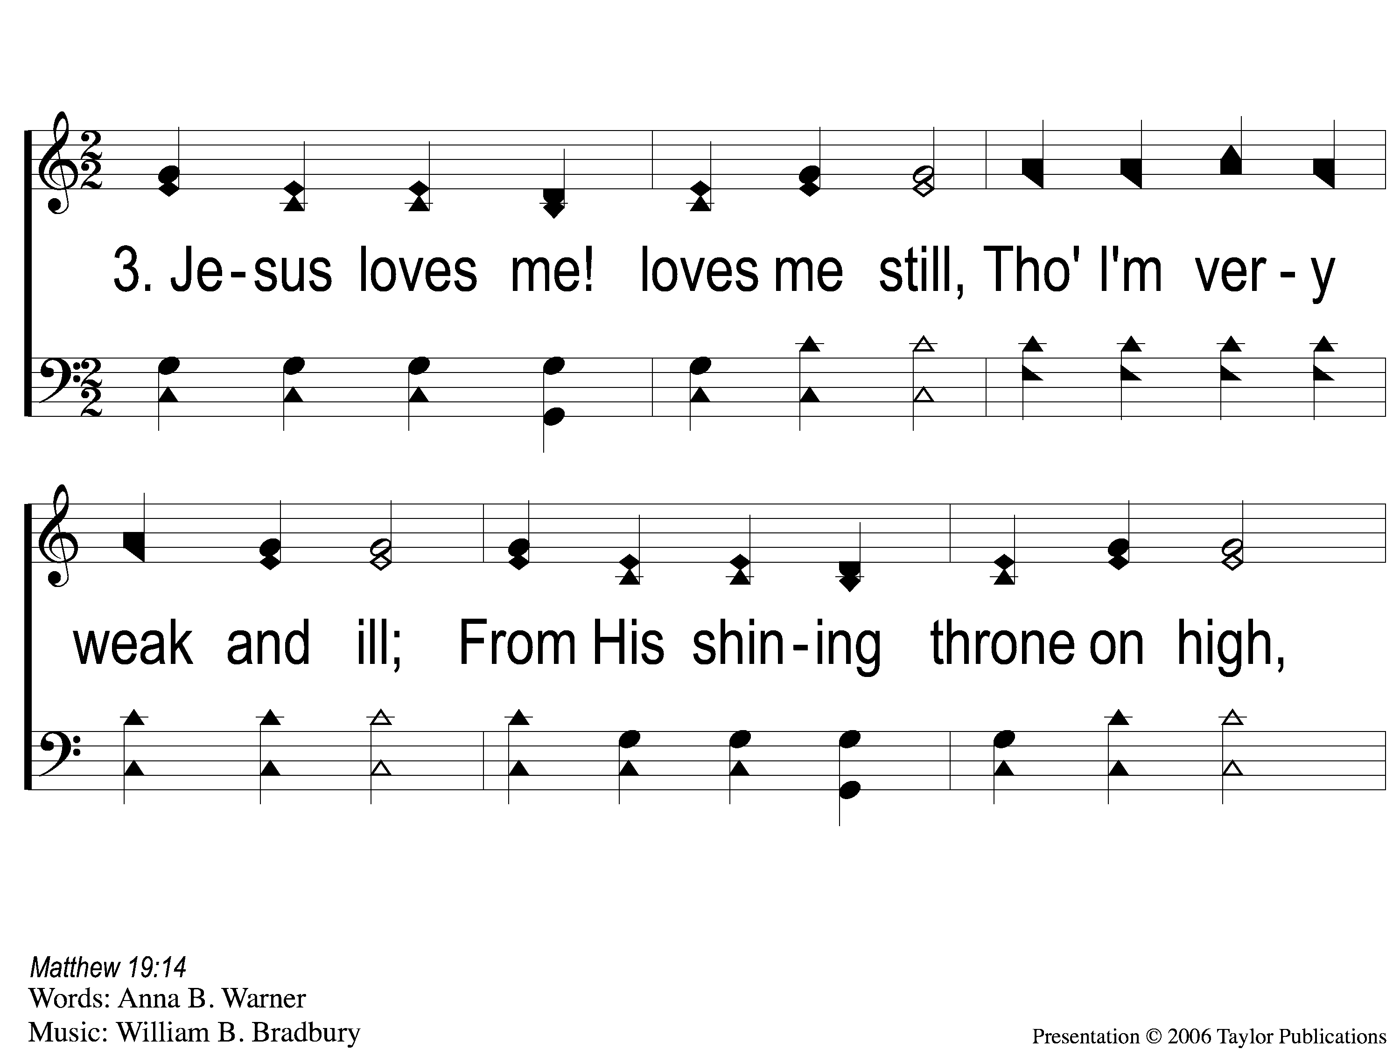
3-1 Jesus Loves Me This I Know
Jesus Loves Me
108

Slide 8
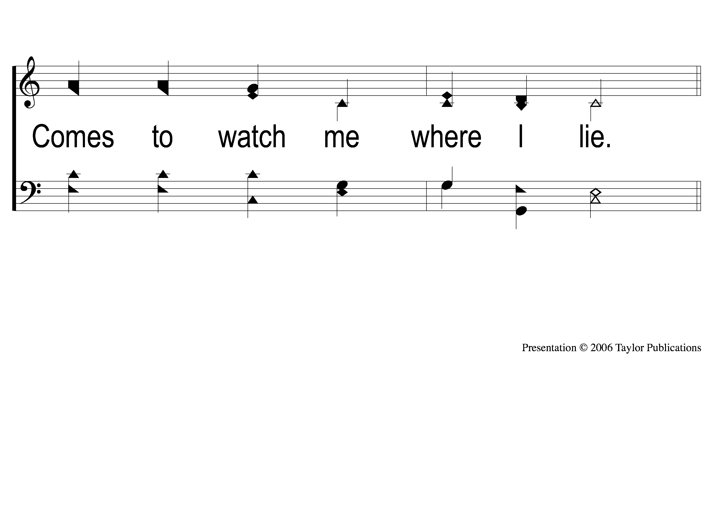
3-2 Jesus Loves Me This I Know
Jesus Loves Me
108

Slide 9
C Jesus Loves Me This I Know
Jesus Loves Me
108

Slide 10
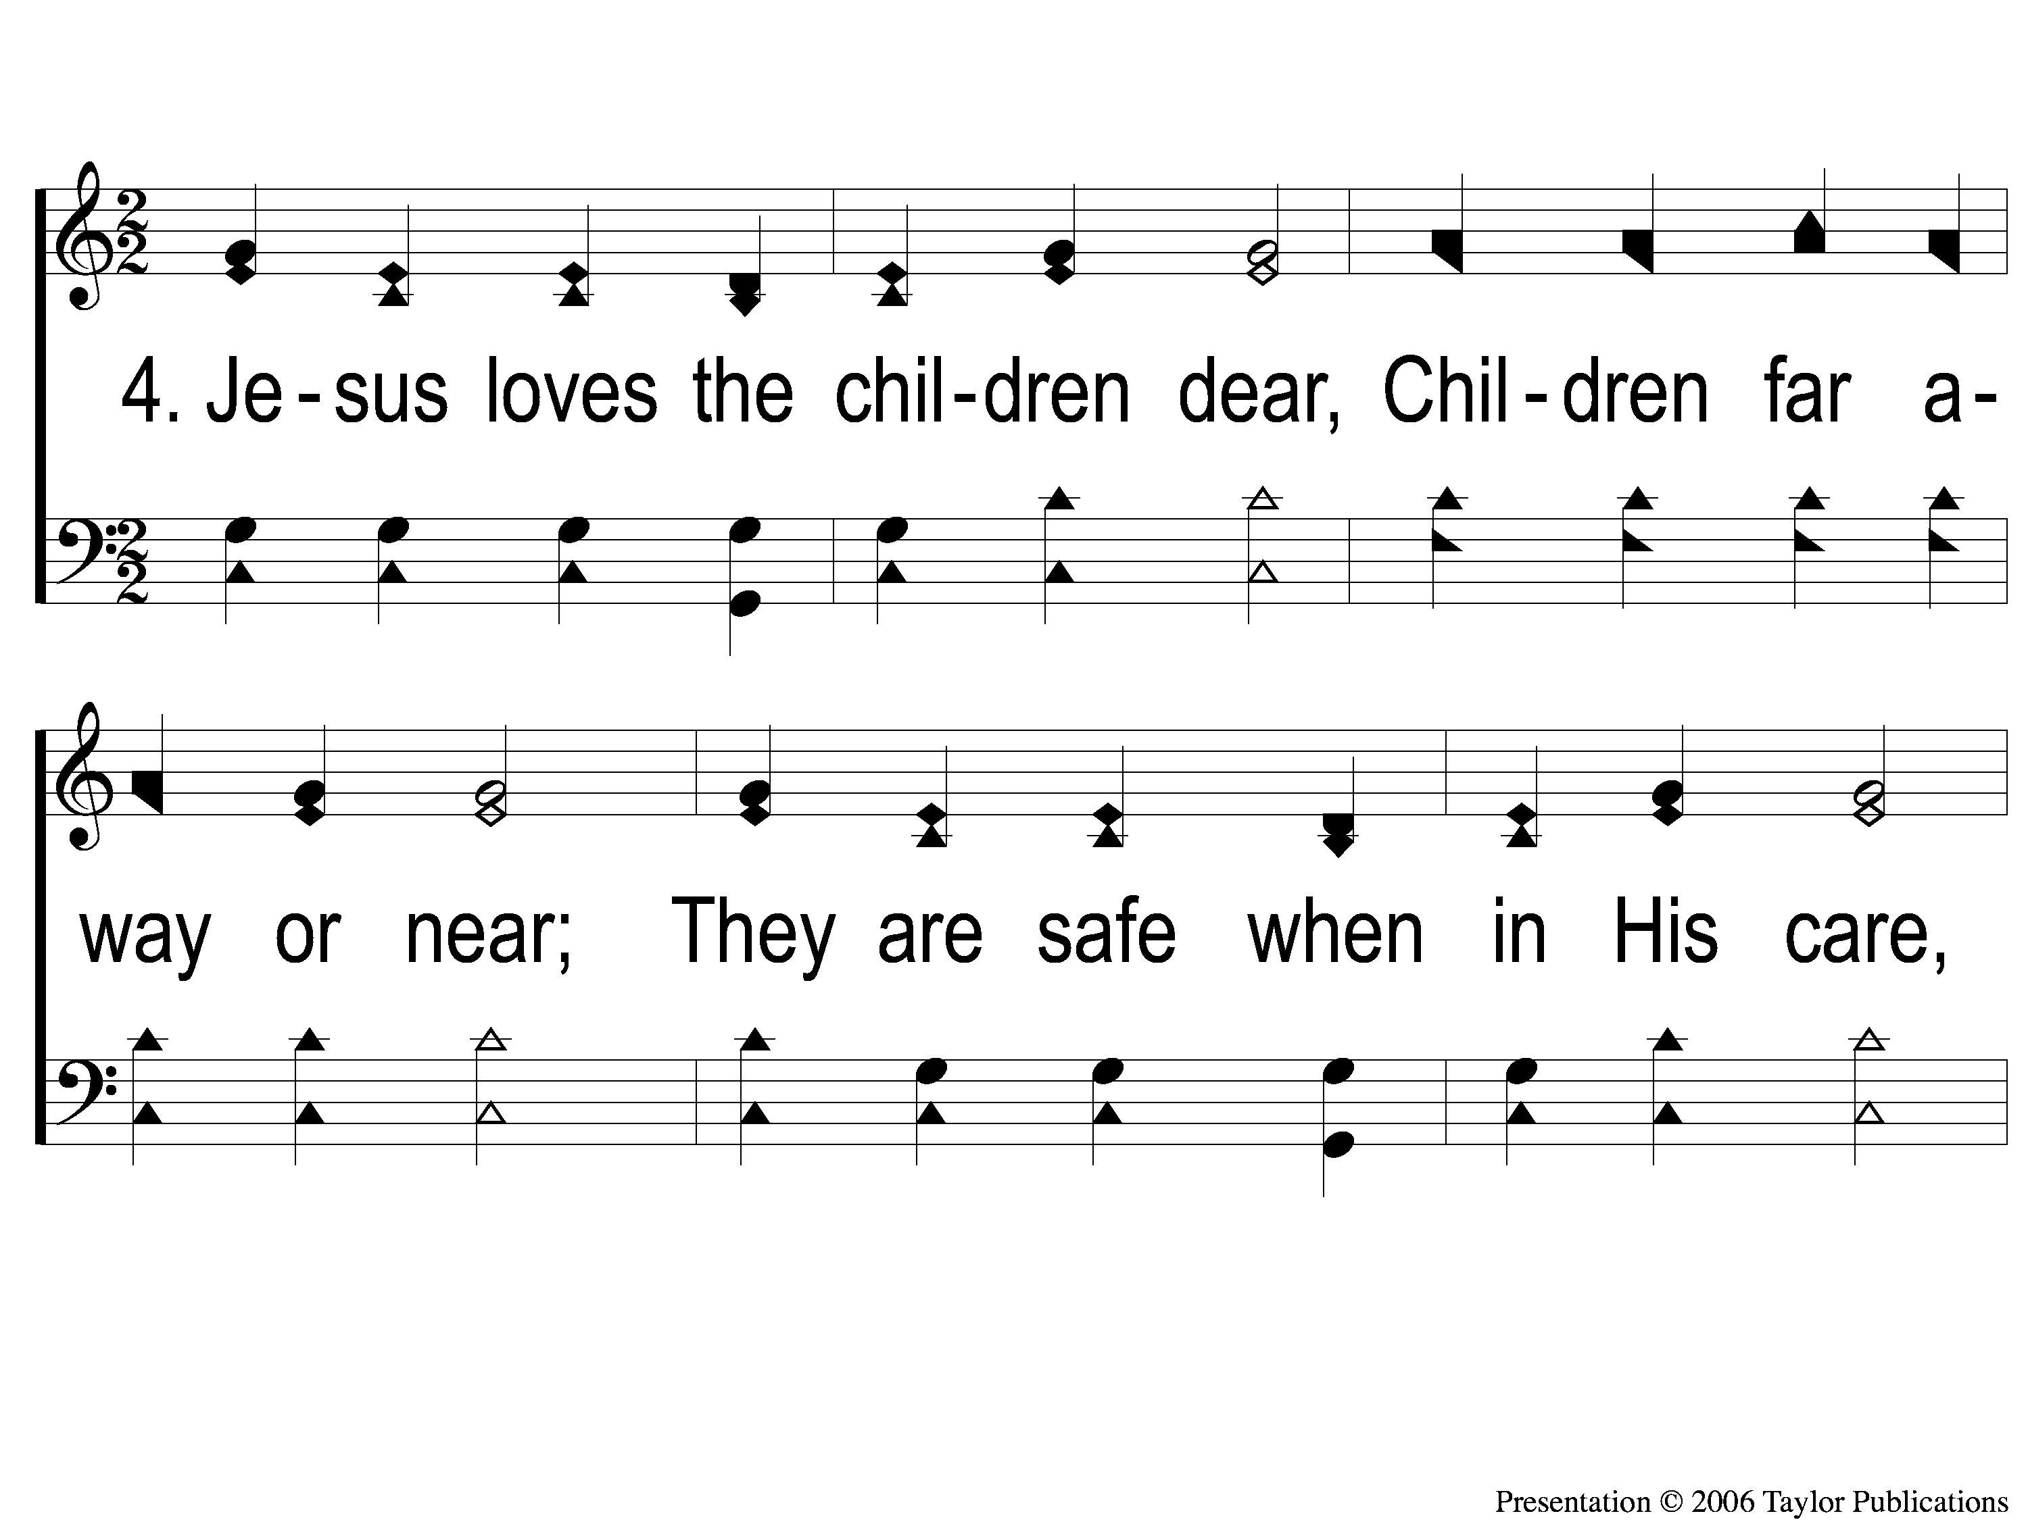
4-1 Jesus Loves Me This I Know
Jesus Loves Me
108

Slide 11
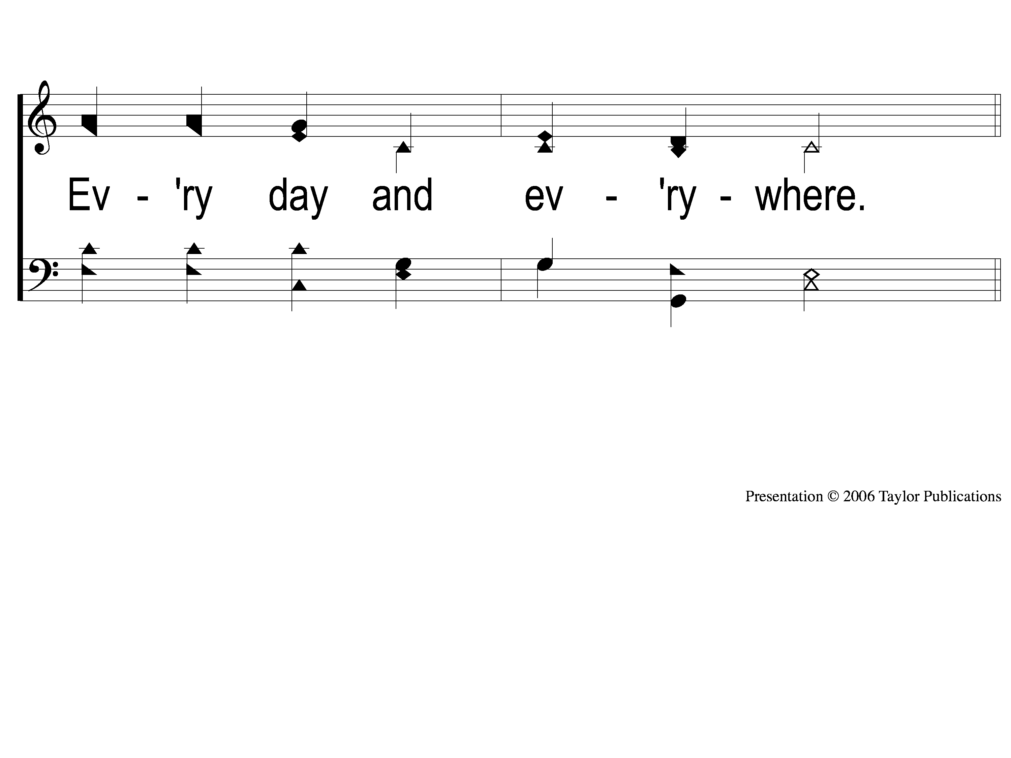
4-2 Jesus Loves Me This I Know
Jesus Loves Me
108

Slide 12
C Jesus Loves Me This I Know
Jesus Loves Me
108

Slide 13
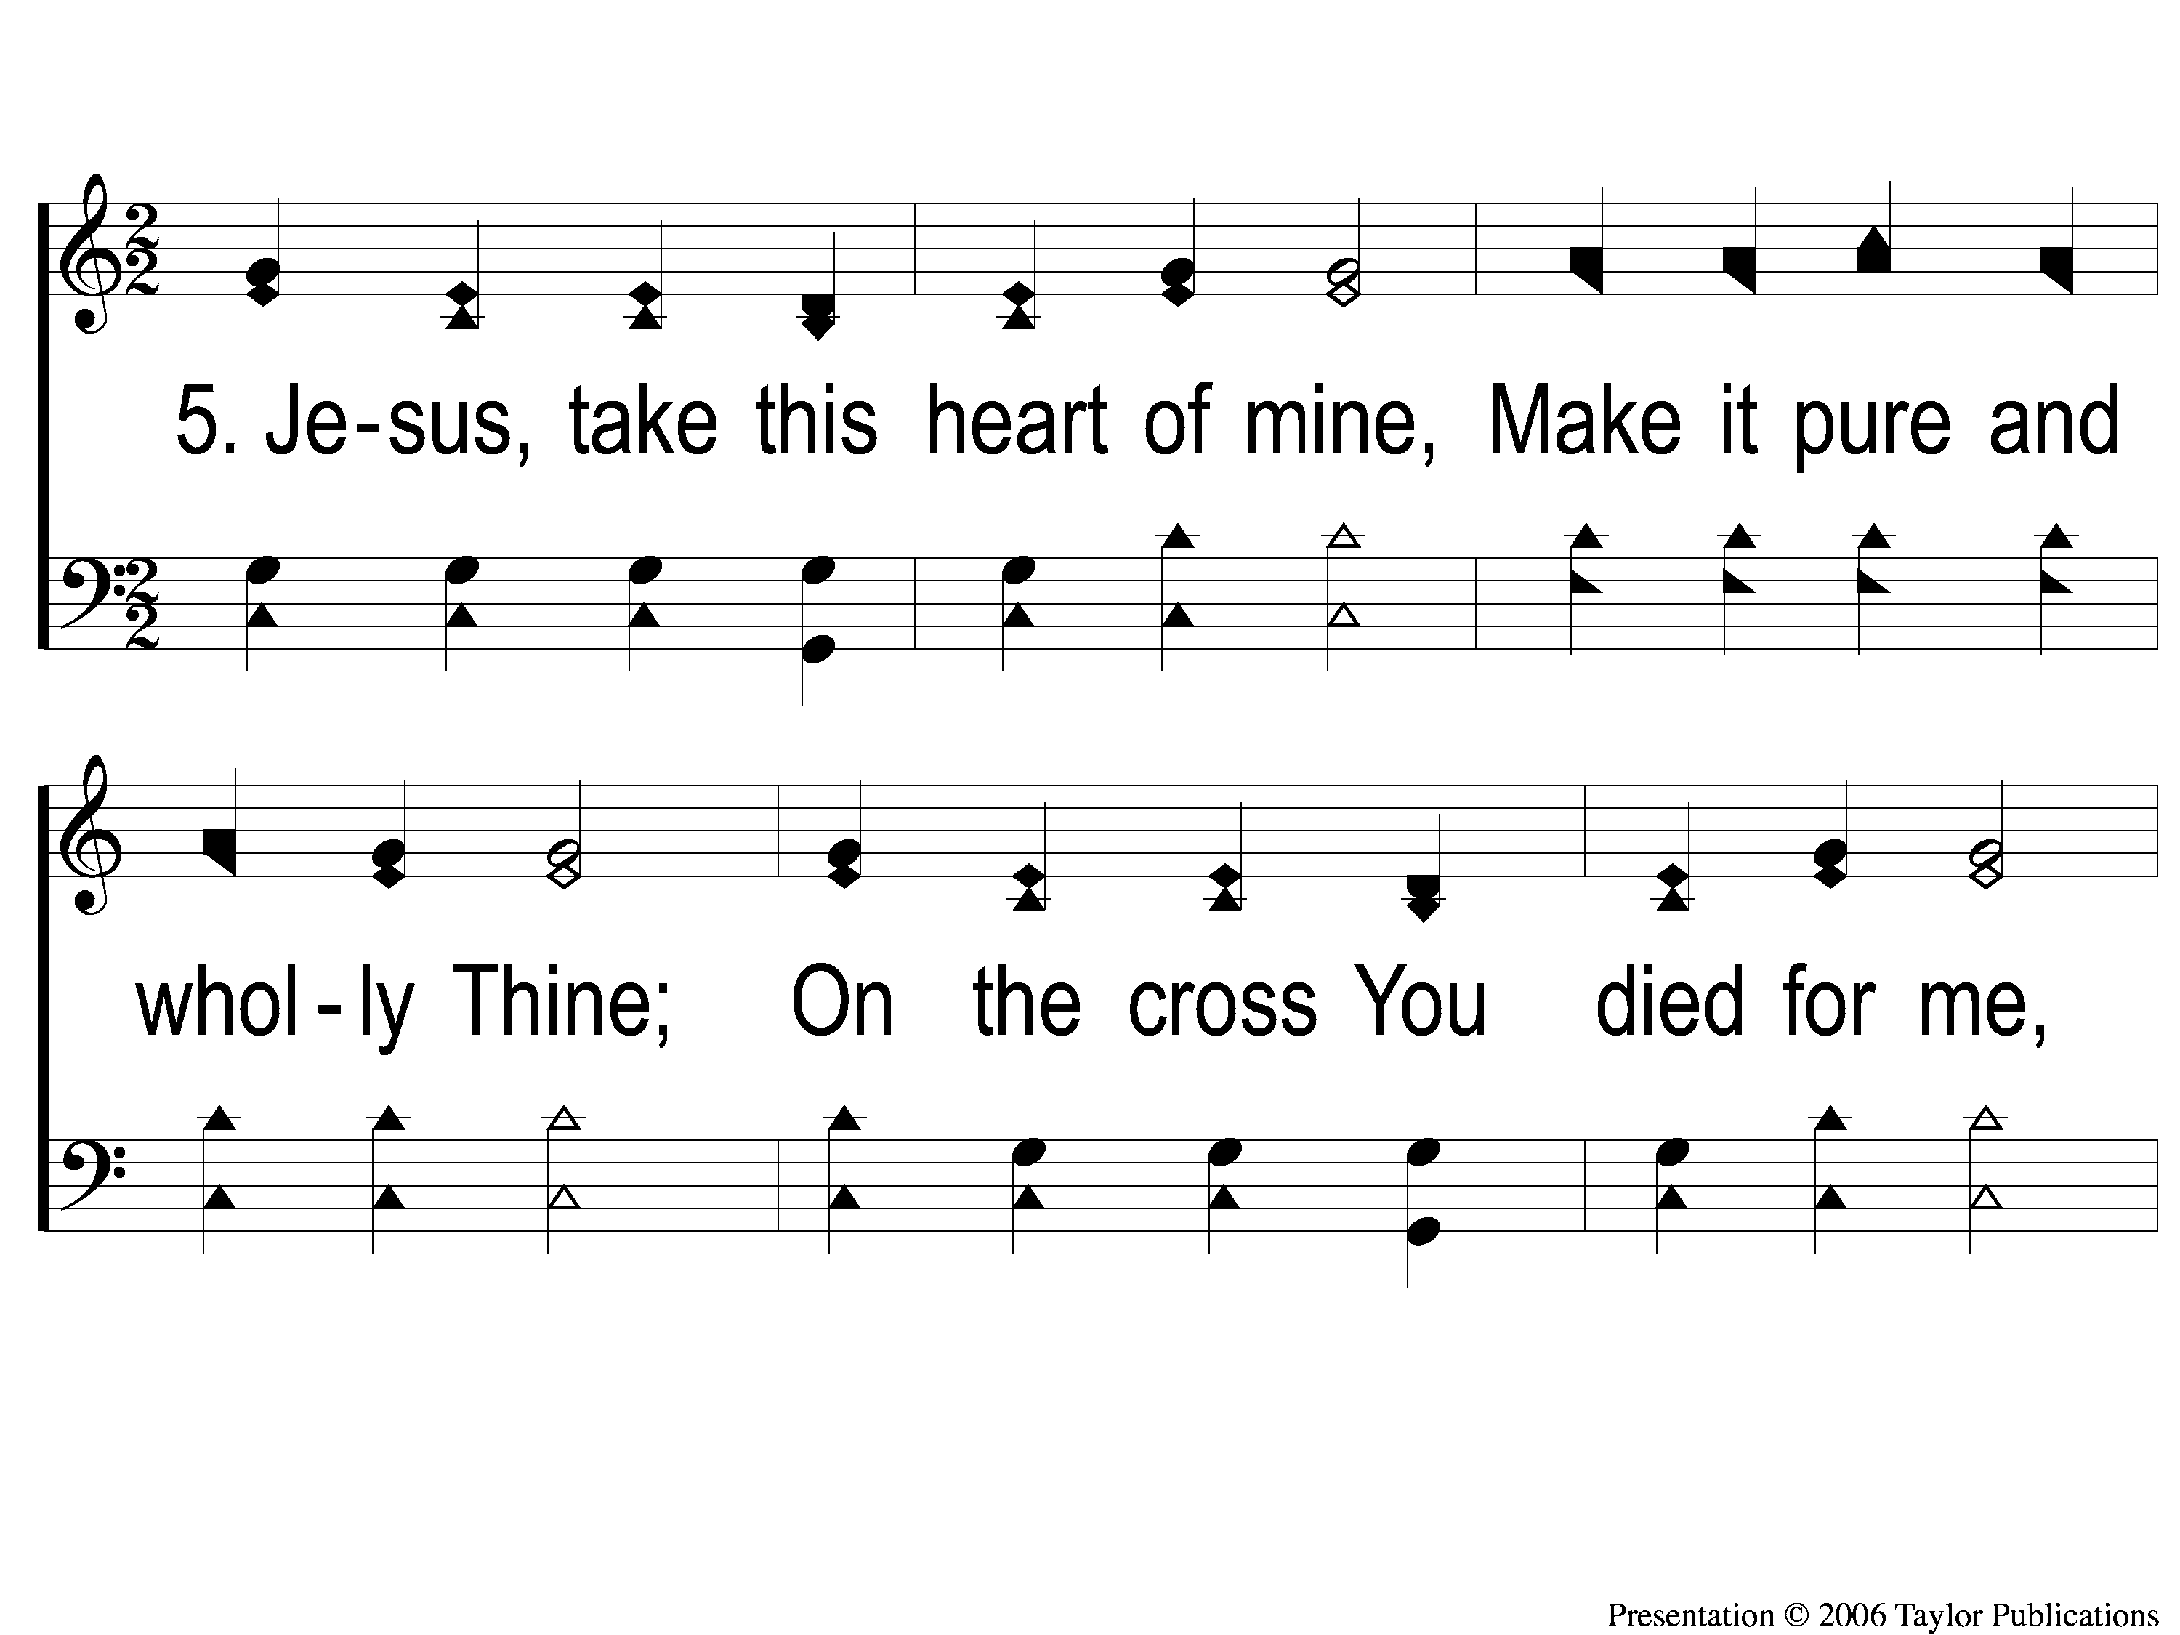
5-1 Jesus Loves Me This I Know
Jesus Loves Me
108

Slide 14
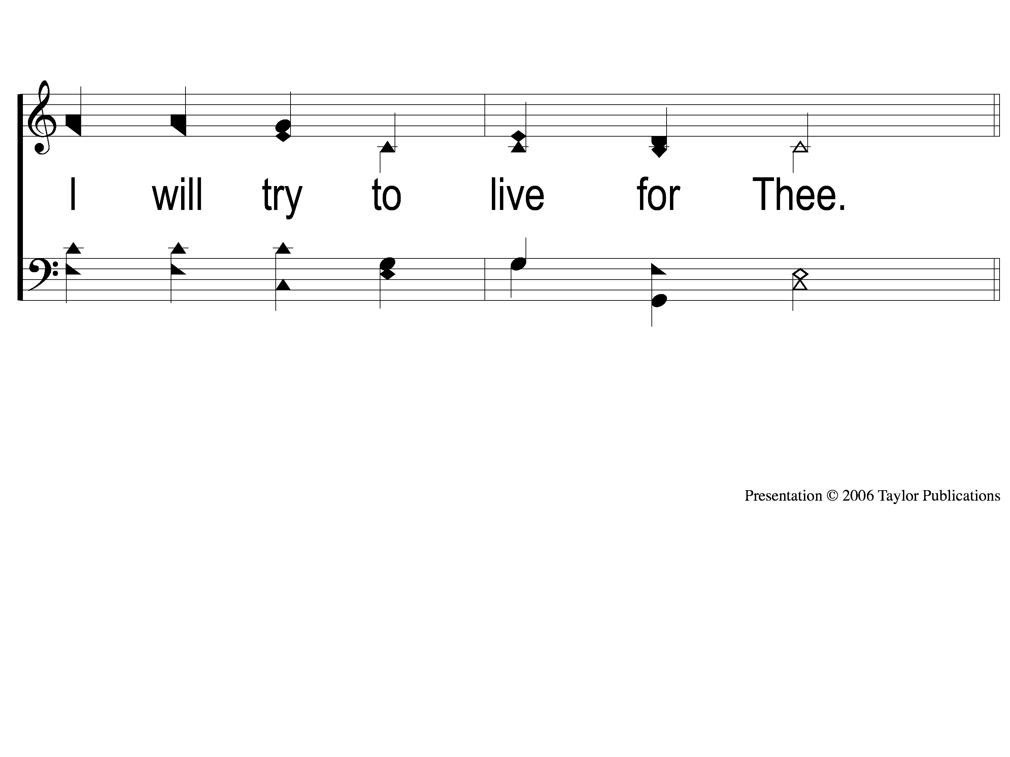
5-2 Jesus Loves Me This I Know
Jesus Loves Me
108

Slide 15
C Jesus Loves Me This I Know
Jesus Loves Me
108

